Slide 1
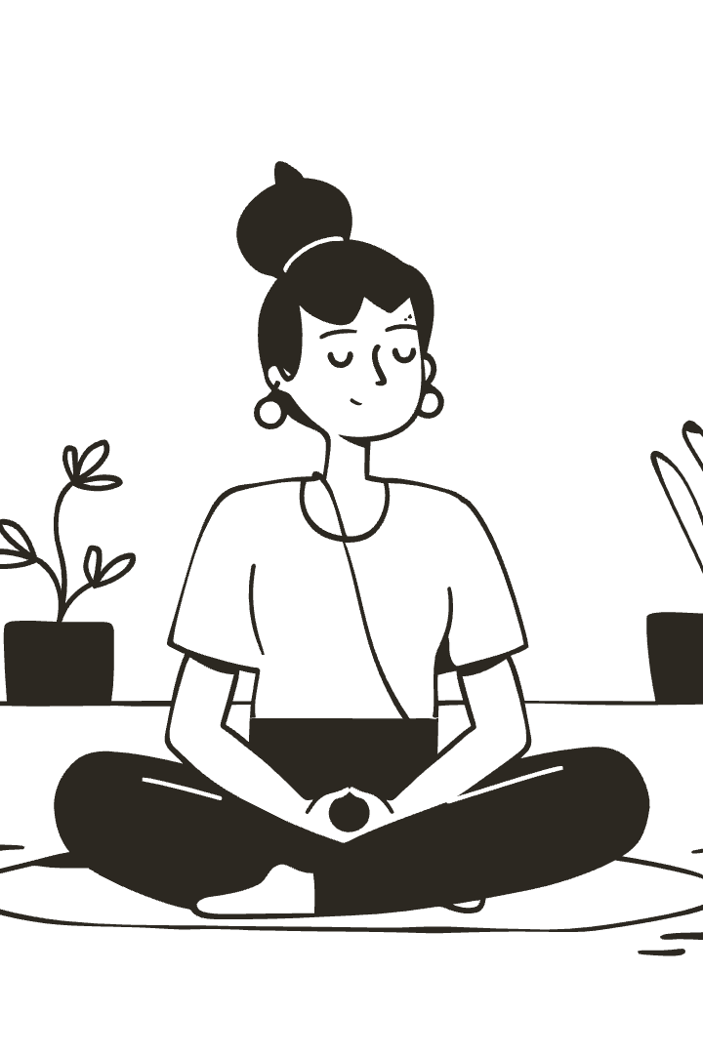

The Power of Now: Finding Freedom in the Present
Explore Eckhart Tolle's transformative book The Power of Now. Learn how to experience life fully by embracing presence.
We will cover key concepts: disidentifying from the mind, living in the present, and acceptance.
by Aetesam Asfar

Slide 2
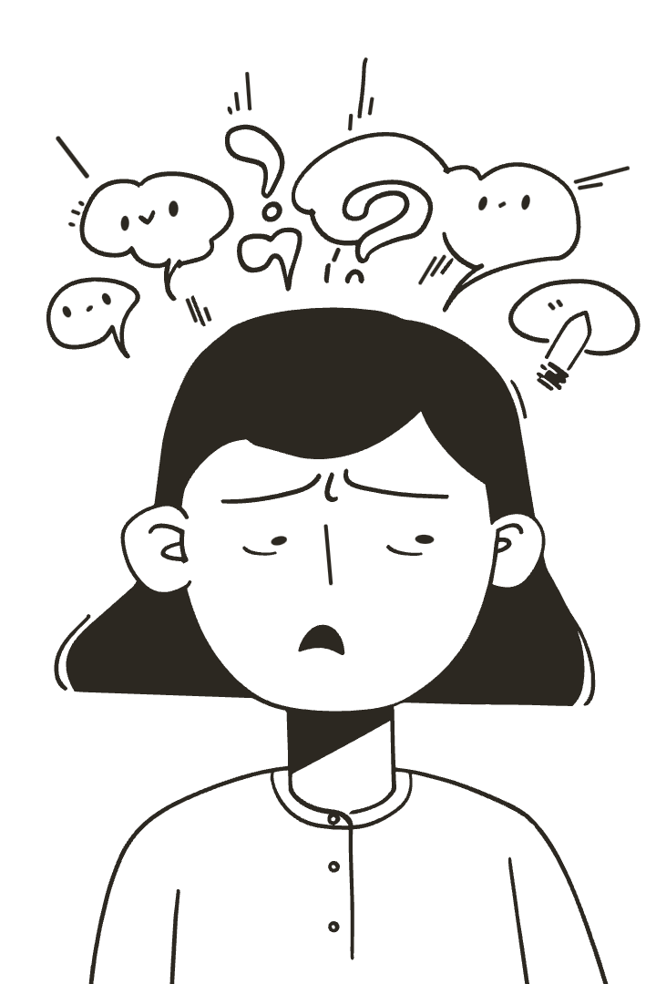
You Are Not Your Mind: Disidentification
The thinker
Constant stream of thoughts is separate from your true self.
Observing thoughts
Notice thoughts without judgment, like watching clouds pass.
Pain-body awareness
Recognize emotional pain linked to past, without identifying with it.
Meditation practice
10 minutes daily to observe mind and disconnect from it.

Slide 3
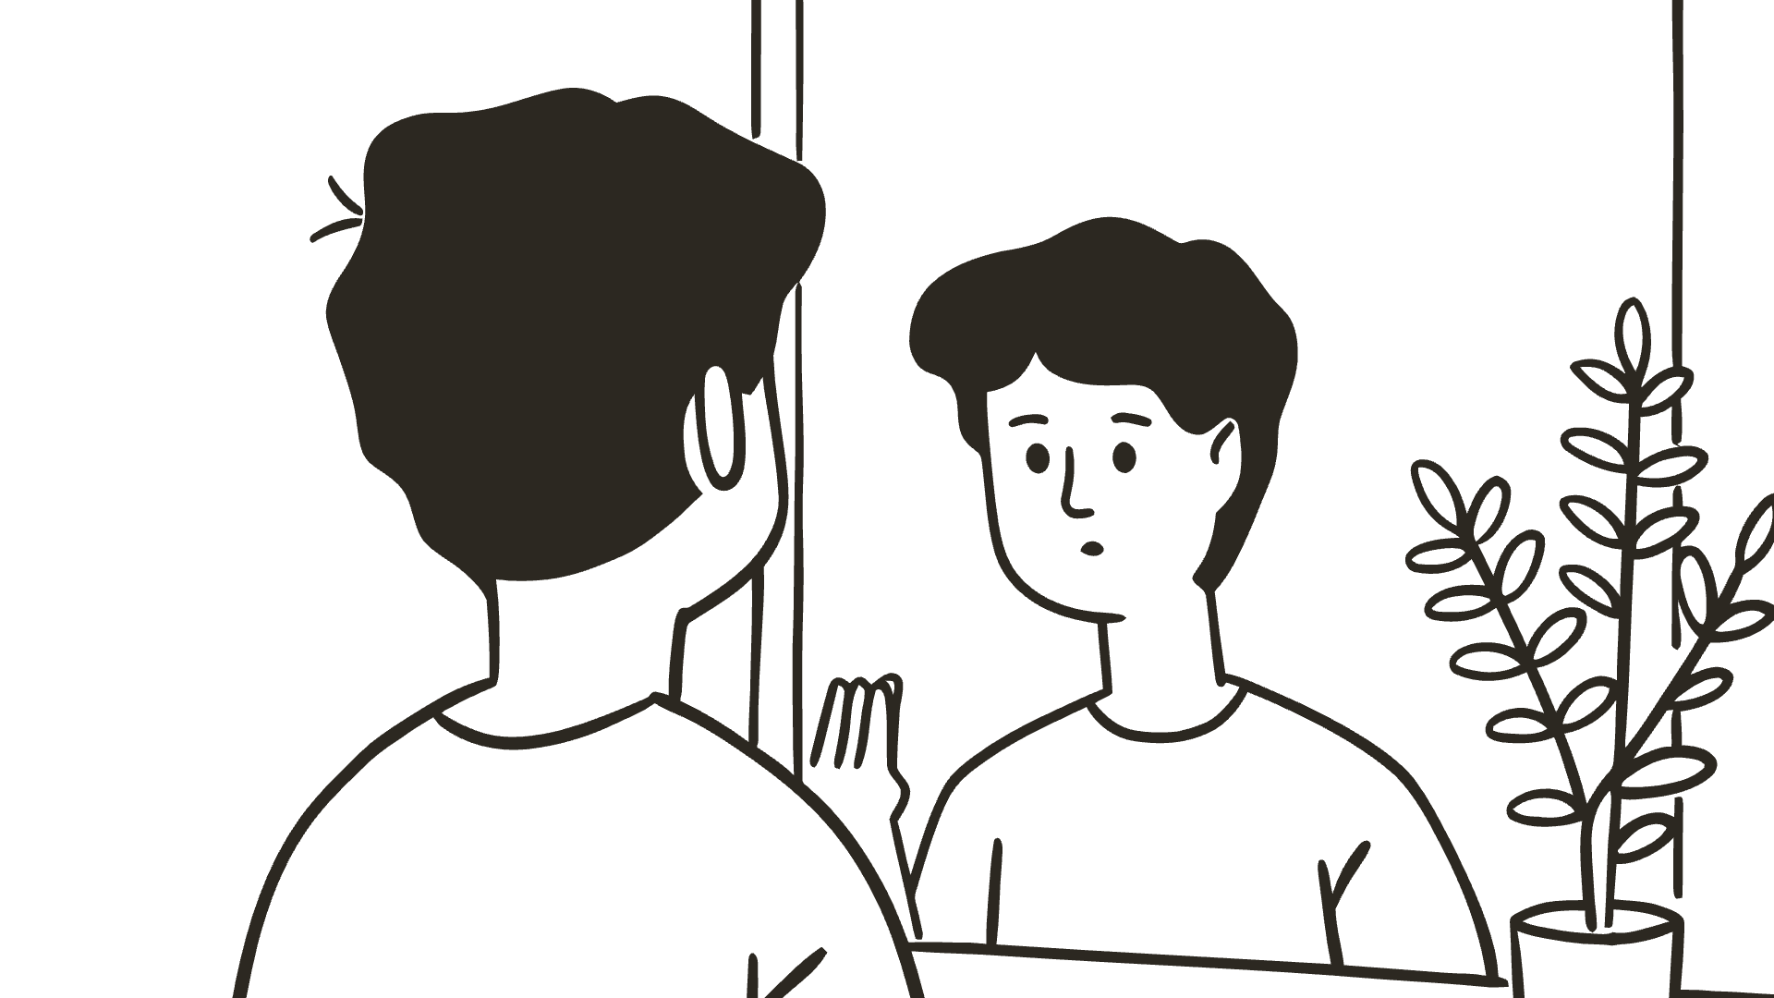
Understanding the Ego
False self
Suffering source
Negative thought patterns
Ego is a mental construct creating separation and control needs.
Ego's identification with form causes pain and unhappiness.
80% of thoughts are repetitive and focus on negativity.

Slide 4
The Present Moment: The Only Reality
Illusion of time
Effects of time fixation
Past and future exist only in the mind.
75% of worries about future are unfounded
Peace is found by focusing on the Now.
Regret comes from dwelling on the past

Slide 5
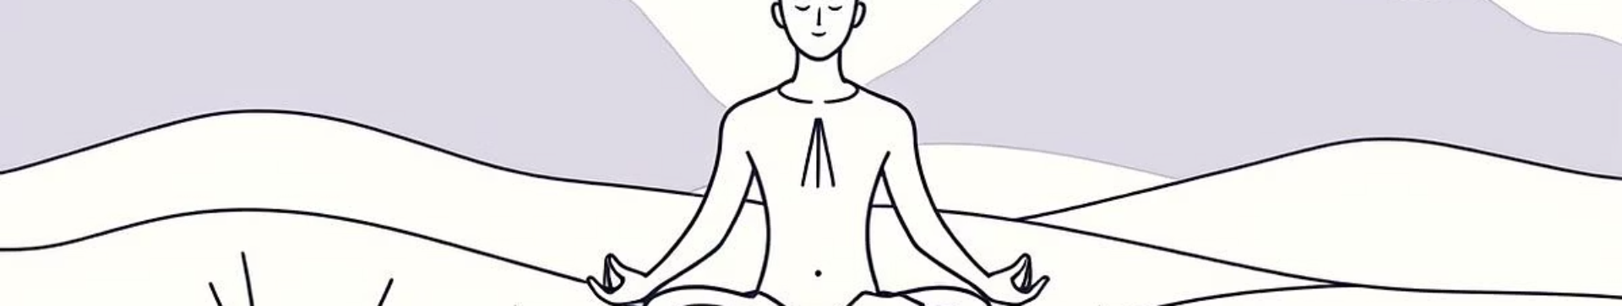




Acceptance of What Is: Surrender and Transformation
Power of acceptance
Resisting the present intensifies suffering.
Choose acceptance
"Accept the present moment as if chosen."
Inner peace foundation
Acceptance enables peace and opens paths to change.
Example situation
Face challenges without judgment, foster transformation.

Slide 6

Transforming Suffering Through Acceptance
Resistance hurts
Fighting reality worsens pain.
Acceptance heals
Welcoming situations eases suffering.
Growth opportunity
Challenges can spark learning and new paths.
Stress reduction
60% less stress with daily acceptance practice.

Slide 7

Personal Reflection

